Slide 1



Junior Interface Developer
Modulo 01 - Visual Studio, .NET Framework e C#
Da Lunedì 19/09/2016 a Lunedì 26/09/2016
Gabriele Gaggi

Slide 2
Parte 5 - Programmazione ad oggetti in C#.NET
Introduzione all'OOP

Slide 3
Classi ed oggetti
Classes:
Are like blueprints for objects
Contain methods and data
Objects:
Are instances of a class
Created using the new keyword
Have actions

Slide 4
Programmazione ad oggetti
Nasce negli anni 60 (SIMULA)
Negli anni 70 nasce SmallTalk
Negli anni 80 C++
Nel 1995 esce Java

Slide 5
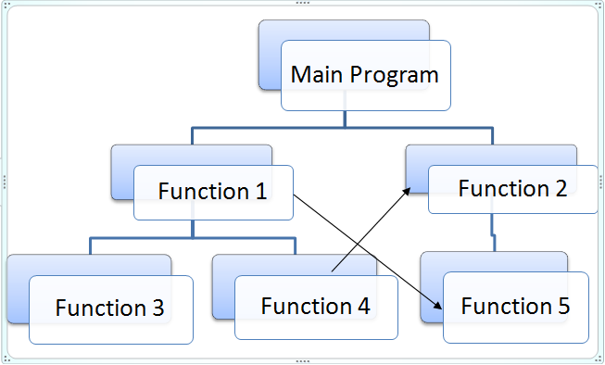
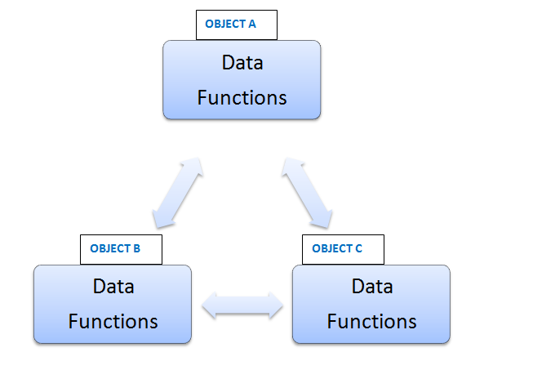
Tipi di programmazione
Procedurale
Ad oggetti

Slide 6
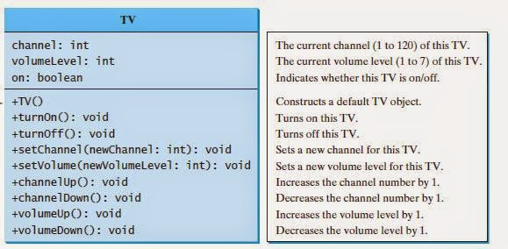
Rappresentazione della realtà
Come funziona la televisione?
Non importa, è utile conoscerne le caratteristiche e le azioni

Slide 7
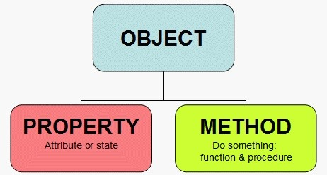
Metodi e proprietà
Metodi: Le azioni che il nostro oggetto è in grado di compiere
Proprietà: Le informazioni su cui opera l’oggetto

Slide 8

Le Classi
E’ una categoria che accomuna gli oggetti simili
Definisce le caratteristiche che avranno gli oggetti istanza
«E’ lo stampo che ci permette di creare (instanziare) oggetti»

Slide 9
Come definire classi ed oggetti
How to define a class
public class Customer {
public string name;
public decimal creditLimit;
public uint customerID;
}
How to instantiate a class as an object
Customer nextCustomer = new Customer();
How to access class variables
nextCustomer.name = "Suzan Fine";

Slide 10
Definizione dell’accessibilità e dello scope
Access modifiers are used to define the accessibility level of class members
Declaration
Definition
public
Access not limited.
private
Access limited to the containing class.
internal
Access limited to this program.
protected
Access limited to the containing class and to types derived from the containing class
protected internal
Access limited to the containing class, derived classes, or to members of this program

Slide 11
Variabili e costanti: Scope
Block scope
Namespace scope
if (length > 10)
{
int area = length * length;
}
public class CreateMessage
{
public string message
= "Hello";
}
public class DisplayMessage
{
public void ShowMessage()
{
CreateMessage newMessage
= new CreateMessage();
MessageBox.Show(
newMessage.message);
}
}
Procedure scope
void ShowName()
{
string name = "Bob";
}
Class scope
private string message;
void SetString()
{
message = "Hello World!";
}

Slide 12
Gli array e ArrayList
An array is a sequence of elements that are grouped together
Array features include:
Every element in the array contains a value
Arrays are zero-indexed
The length of an array is the total number of elements it can contain
The lower bound of an array is the index of its first element
Arrays can be single-dimensional, multidimensional, or jagged
The rank of an array is the number of dimensions in the array

Slide 13
Gli array e ArrayList
An array can have more than one dimension
Single
Type[] arrayName = new Type[ Size ];
Multiple
Type[ , ] arrayName = new Type[ Size1, Size2];
Jagged
Type [][] JaggedArray = new Type[size][];

Slide 14
Gli array e ArrayList
Length
int[] oldNumbers = { 1, 2, 3, 4, 5 };
int numberCount = oldNumbers.Length;
Rank
int[] oldNumbers = { 1, 2, 3, 4, 5 };
int rank = oldNumbers.Rank;
CopyTo()
int[] oldNumbers = { 1, 2, 3, 4, 5 };
int[] newNumbers = new
int[oldNumbers.Length];
oldNumbers.CopyTo(newNumbers, 0);
Sort()
int[] oldNumbers = { 5, 2, 1, 3, 4 };
Array.Sort(oldNumbers);

Slide 15
Gli array e ArrayList
Elements are accessed from 0 to N-1
Accessing specific elements
int[] oldNumbers = { 1, 2, 3, 4, 5 };
int number = oldNumbers[2];
// OR
object number = oldNumbers.GetValue(2);
Iterating through all elements
int[] oldNumbers = { 1, 2, 3, 4, 5 };
...
for (int i = 0; i < oldNumbers.Length; i++)
{
int number= oldNumbers[i];
}
// OR
foreach (int number in oldNumbers) { ... }

Slide 16
Cos’è una collezione
int
4
int
4
int
4
Add:
Remove:
string
“Rich”
string
“Rich”
string
“Rich”
bool
true
int
5
int
5
int
5
bool
true
bool
true
Items in a collection are referenced by using the System.Object type
Collections manage space automatically

Slide 17
Gli array e ArrayList
Lists, queues, stacks, and hash tables are common ways to manage data in an application
List: A collection that allows you access by index
Example: An array is a list; an ArrayList is a list
Queue: First-in, first-out collection of objects
Example: Waiting in line at a ticket office
Stack: Last-in-first-out collection of objects
Example: A pile of plates
Hash table: Represents a collection of associated keys and values organized around the hash code of the key
Example: A dictionary

Slide 18
Utilizzare le collection
ICollection interface:
CopyTo
GetEnumerator
Count
Implemented by all collection classes
IList interface:
Add
Remove
Implemented by some collection classes
Items are stored in collections as objects. You must cast items retrieved from the collection
Some collection classes use alternatives such as Push and Pop instead of Add and Remove
ArrayList list = new ArrayList();
list.Add(6);
list.Remove(6);
list.RemoveAt(1);
int temp = (int)list[0]);

Slide 19
ArrayList Class
ArrayList does not have a fixed size; it grows as needed
Use Add(object) to add an object to the end of the ArrayList
Use [] to access elements in the ArrayList
Use TrimToSize() to reduce the size to fit the number of elements in the ArrayList
Use Clear to remove all the elements
Can set the capacity explicitly

Slide 20
Iterare una collezione
A foreach loop displays every item in a collection in turn
foreach(<type> <control_variable> in <collection>)
{
<foreach_statement_body>
}
To use a foreach loop, the collection must expose an enumerator. The ICollection interface defines a GetEnumerator method
ArrayList list = new ArrayList();
list.Add(99);
list.Add(10001);
list.Add(25);
...
foreach (int i in list)
{
Console.WriteLine(i);
}
// Output: 99 // 10001 // 25

Slide 21
Inizializzare una collezione
You can use the Add method to add items to a collection
ArrayList al = new ArrayList();
al.Add("Value");
al.Add("Another Value");
You can also use a collection initializer to add items to a collection when you define the collection
// Assume person1 and person 2 are instantiated // Person objects.
ArrayList al2 = new ArrayList()
{
person1,
person2
};
You can combine collection initializers with object initializers
ArrayList al3 = new ArrayList()
{
new Person() {Name="James", Age =45},
new Person() {Name="Tom", Age =31}
};

Slide 22
Queues e Stacks
Queues: first-in, first-out
Enqueue places objects in the queue
Dequeue removes objects from the queue
Stacks: last-in, first-out
Push places objects on the stack
Pop removes objects from the stack
Count gets the number of objects contained in a stack or queue

Slide 23
Hash Tables
A hash table is a data structure that associates a key with an object, for rapid retrieval
Key
Object
Book techBook = new Book("Inside C#", 0735612889);
// ...
public Hashtable bookList;
//
bookList.Add(0735612889, techBook);
//
Book b = (Book) bookList[0735612889];
// b’s title is "Inside C#"

Slide 24
Parte 5 - Programmazione ad oggetti in C#.NET
Metodi, Proprietà e membri
Le Classi e le istanze (differenze)
Costruttori e Distruttori
Incapsulamento
L'ereditarietà
Il Polimorfismo: Overloading e Overriding di metodi e operatori
Ciclo di vita degli oggetti: costruttori, distruttori, pattern IDisposable

Slide 25
Funzioni e routine
A method is a class member that contains a code block that represents an action:
All executable code belongs to a method
A C# application must have at least one method
Methods can be defined for private use by a type, or for
public use by other types
The Main method defines the starting point for an application
C# supports instance and static methods
Instance method
Static method
int count = 99;
string strCount =
count.ToString();
string strCount = “99”;
count =
Convert.ToInt32(strCount);

Slide 26
Funzioni e routine
A method contains:
The method specification (access, return type, and signature)
The method body (code)
Method signature:
Name (Pascal case)
Each method signature must be unique in a programming type
1
Parameters (camel case)
2
Example
bool LockReport(string userName)
{
bool success = false;
// Perform some processing here.
return success;
}

Slide 27
Funzioni e routine
To call a method:
Specify the method name
Provide an argument for each parameter
Handle the return value
Example method
bool LockReport(string reportName, string userName)
{
...;
}
Method call
Note: Arguments are evaluated in left-to-right order
bool isReportLocked =
LockReport("Medical Report", “Don Hall");

Slide 28
Funzioni e routine
An overloaded method:
Has the same name as an existing method
Should perform the same operation as the existing method
Uses different parameters to perform the operation
The compiler invokes the version that is appropriate to the arguments that are specified when the method is called
Example
void Deposit(decimal amount)
{
_balance += amount;
}
void Deposit(int dollars, int cents)
{
_balance += dollars + (cents / 100.0m);
}
The signature of the Deposit method is different for each implementation

Slide 29
Funzioni e routine
Overloading may not be possible or appropriate if a method can take a variable number of arguments
Example
int Add(params int[] data)
{
int sum = 0;
for (int i = 0; i < data.Length; i++)
{
sum += data[i];
}
return sum;
}
Method call
int sum = Add(99, 2, 55, -26);

Slide 30
Funzioni e routine
Select the code that you want to extract to a
method, right-click, point to Refactor, and then
click Extract Method
1
In the Extract Method dialog box, in the New
method name box, type a name for the method,
and then click OK
2
Example of refactored output
LogMessage(messageContents, filePath);
...
private void LogMessage(string messageContents, string filePath)
{
...
}

Slide 31
Funzioni e routine
How to Pass Parameters by Reference
Using the ref keyword
Definite assignment
Using the out parameter keyword
Allows you to initialize a variable in a method
public void GetAddress(ref int number,
ref string street) {
number = this.number;
street = this.street;
}
. . .
int sNumber = 0; string streetName = null;
zoo.GetAddress( ref sNumber, ref streetName );
// sNumber and streetName have new values

Slide 32
Value types e Reference Types
Value types
Reference types
Directly contain data
Stored on the stack
Must be initialized
Cannot be null
An int is a value type
Contain a reference to the data
Stored on the heap
Declared using new keyword
.NET garbage collection handles destruction
A class is a reference type
int i;
i = 42;
CostObject c;
i
c
42
42

Slide 33
Funzioni e routine
How to Pass a Reference Type
When you pass a reference type to a method, the method can alter the actual object
class Zoo {
public void AddLion( Lion newLion ) {
newLion.location = "Exhibit 3";
. . .
}
}
. . .
Zoo myZoo = new Zoo();
Lion babyLion = new Lion();
myZoo.AddLion( babyLion );
// babyLion.location is "Exhibit 3"

Slide 34
Creating and Using Generic Types
What Are Generic Types?
Compiling Generic Types and Type Safety
Defining a Custom Generic Type
Adding Constraints to Generic Types
Demonstration: Defining a Generic Type

Slide 35
What Are Generic Types?
A generic type is a type that specifies one or more type parameters
Type parameters are like other parameters except that they represent a type, not an instance of a type
Type parameters are defined by using angle brackets after the class name
public class List<T>
This code example shows the definition of a class named List that takes a single type parameter named T. You can use T like any other type in the class

Slide 36
Compiling Generic Types and Type Safety
The List<T> class is used several times with different type parameters
List<string> names = new List<string>();
names.Add("John");
...
string name = names[0];
List<List<string>> listOfLists = new List<List<string>>();
listOfLists.Add(names);
...
List<string> data = listOfLists[0];
The compiler generates a strongly typed equivalent of the generic class, effectively generating the following methods
public void Add(string item)
...
public void Add(List<string> item)
The compiler-generated classes and methods are generated when your application is compiled. You cannot call the strongly typed version directly

Slide 37
Nullable Types
I tipi nullable sono istanze della struttura System.Nullable<T>.
Un tipo nullable può rappresentare l'intervallo corretto di valori per il relativo tipo di valore sottostante, più un valore null aggiuntivo.
Ad esempio, a un oggetto Nullable<Int32>, che si legge "Nullable di Int32", può essere assegnato un qualsiasi valore compreso tra -2147483648 e 2147483647 oppure il valore null.
A un oggetto Nullable<bool> è possibile assegnare i valori true, false o null.

Slide 38
Nullable Types
I tipi nullable rappresentano variabili di tipo di valore a cui è possibile assegnare il valore di null. Non è possibile creare un tipo nullable basato su un tipo di riferimento. (I tipi di riferimento supportano già il valore null.)
La sintassi T? è una forma abbreviata dell'oggetto Nullable<T>, in cui l'oggetto T è un tipo di valore. Le due forme sono intercambiabili.
Assegnare un valore a un tipo nullable come se fosse un tipo di valore ordinario, ad esempio int? x = 10; o double? d = 4.108. È possibile inoltre assegnare un valore null: int? x = null. al tipo nullable.
Utilizzare il metodo Nullable<T>.GetValueOrDefault per restituire il valore assegnato o il valore predefinito per il tipo sottostante se il valore è null, ad esempio int j = x.GetValueOrDefault();

Slide 39
Nullable Types
Utilizzare le proprietà di sola lettura HasValue e Value per controllare i valori Null e recuperare il valore, come illustrato nell'esempio seguente: if(x.HasValue) j = x.Value;
La proprietà HasValue restituisce true se la variabile contiene un valore o false se è null.
La proprietà Value restituisce un valore se ne è stato assegnato uno. In caso contrario, verrà generata un'eccezioneSystem.InvalidOperationException.
Il valore predefinito di HasValue è false. La proprietà Value non ha valori predefiniti.
È anche possibile utilizzare gli operatori == e != con un tipo nullable, come illustrato nel seguente esempio: if (x != null) y = x;

